Slide 1
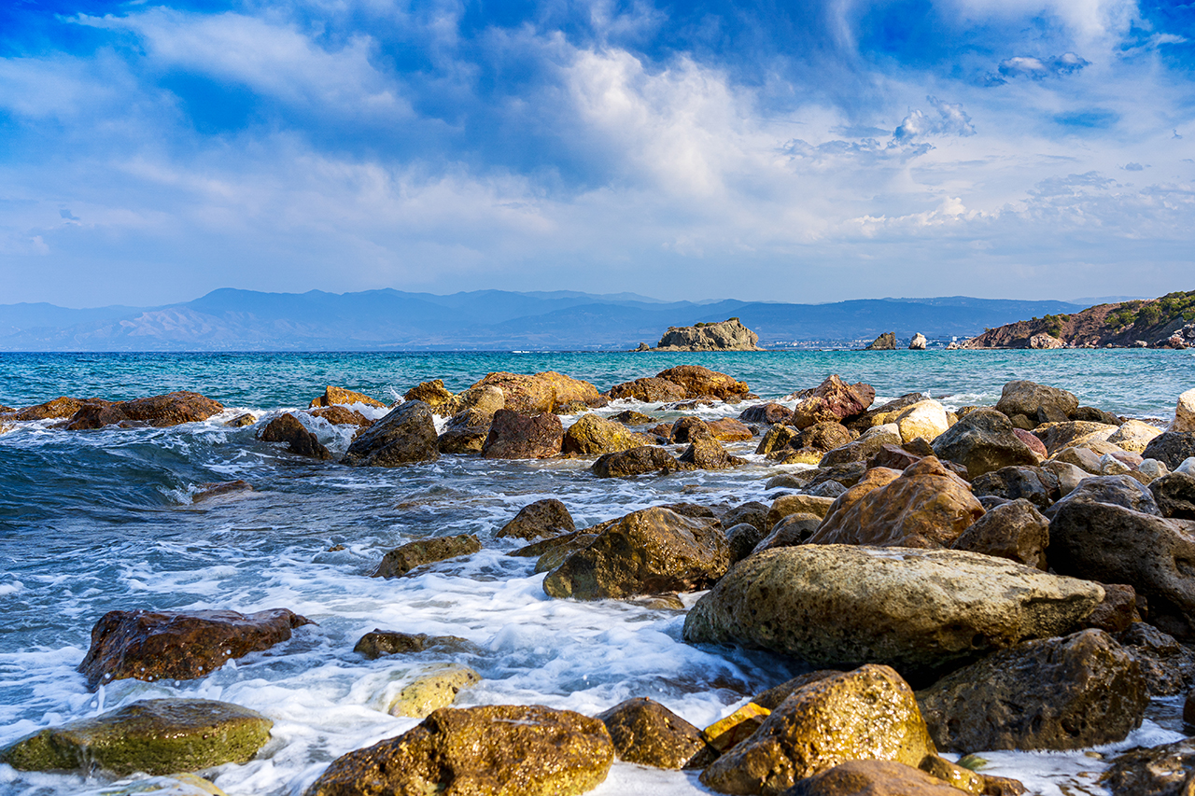
Bruce County Smart Beach Predict People on the Beach

Slide 2
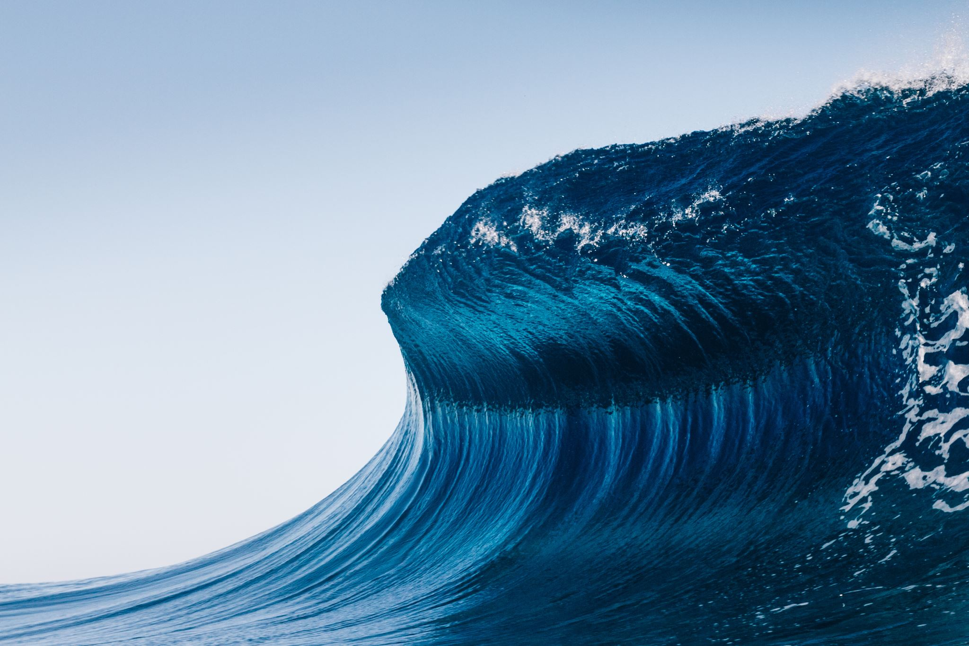

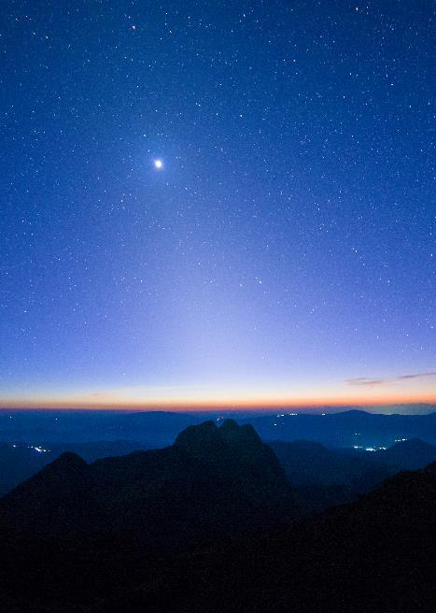
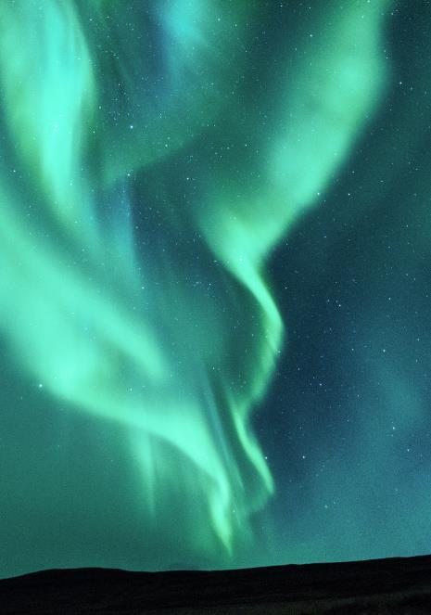
Agenda
Introduction
Team Profile
Project Summary
Project Progress Update
Plans for the weekly status report
Individual contributions
Communication plan
Gantt Chart
Summary

Slide 3
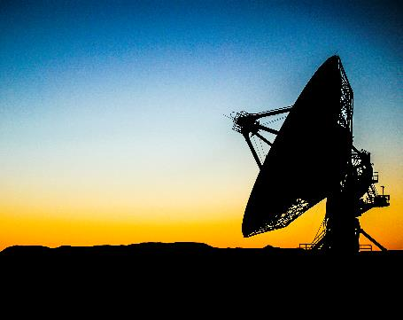
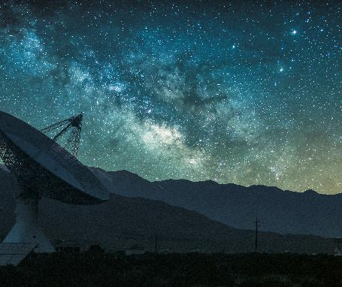
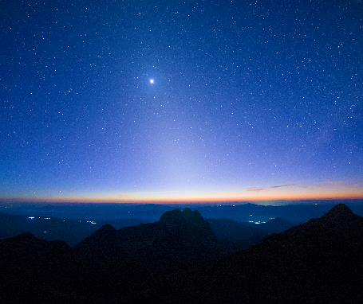
Introduction
The Smart Beach Project of Bruce county, spearheaded by the Nuclear Innovation Institute's Municipal Innovation Council (MIC) in collaboration with local stakeholders, is a forward-thinking government organization dedicated to advancing technology for the enhancement of human safety aims to revolutionize beach safety in Kincardine, Ontario. The initiative comes in response to a community-driven desire to enhance safety at Station Beach, which has experienced unfortunate incidents over the past decade. With the increasing importance of beach safety, they have undertaken a mission to create a proactive and comprehensive system that ensures the well-being of every visitor.

Slide 4
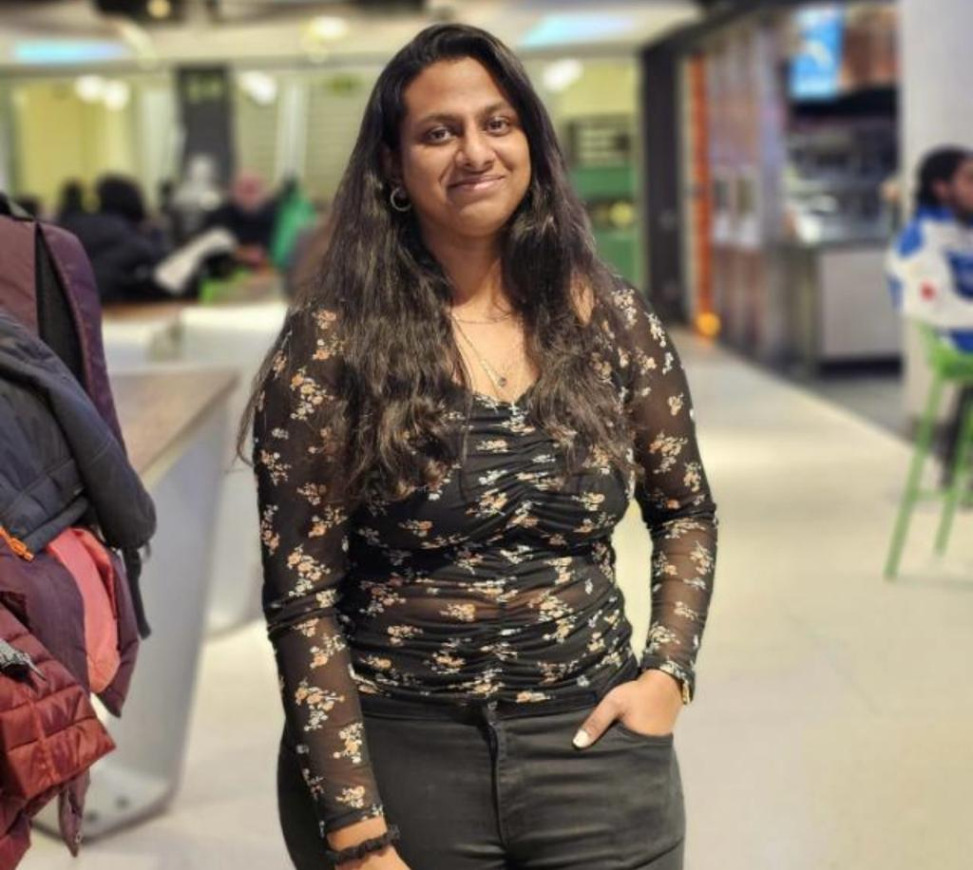
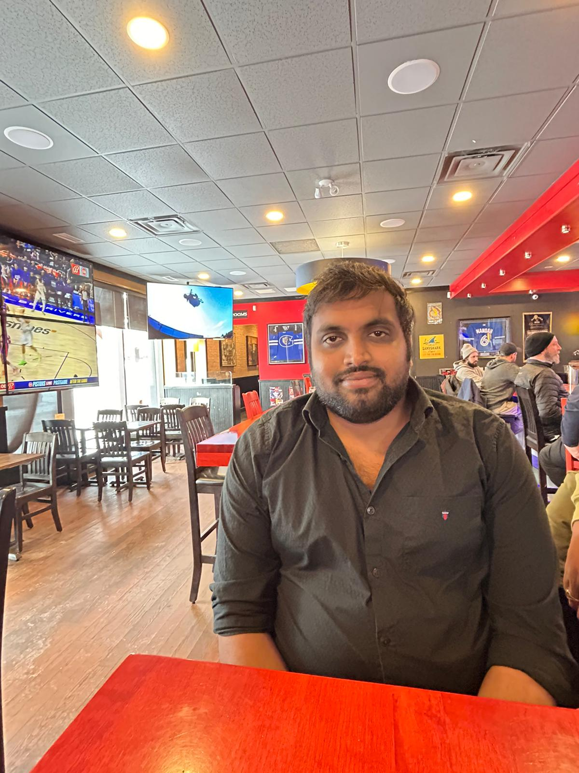


Team Introduction
Mahima Srinivasan
200576720
Nishanth Sai Chirumamilla
200577557
Vinay Kumar Dontaramaina
200573257
Developer
Data Analyst
Tester

Slide 5
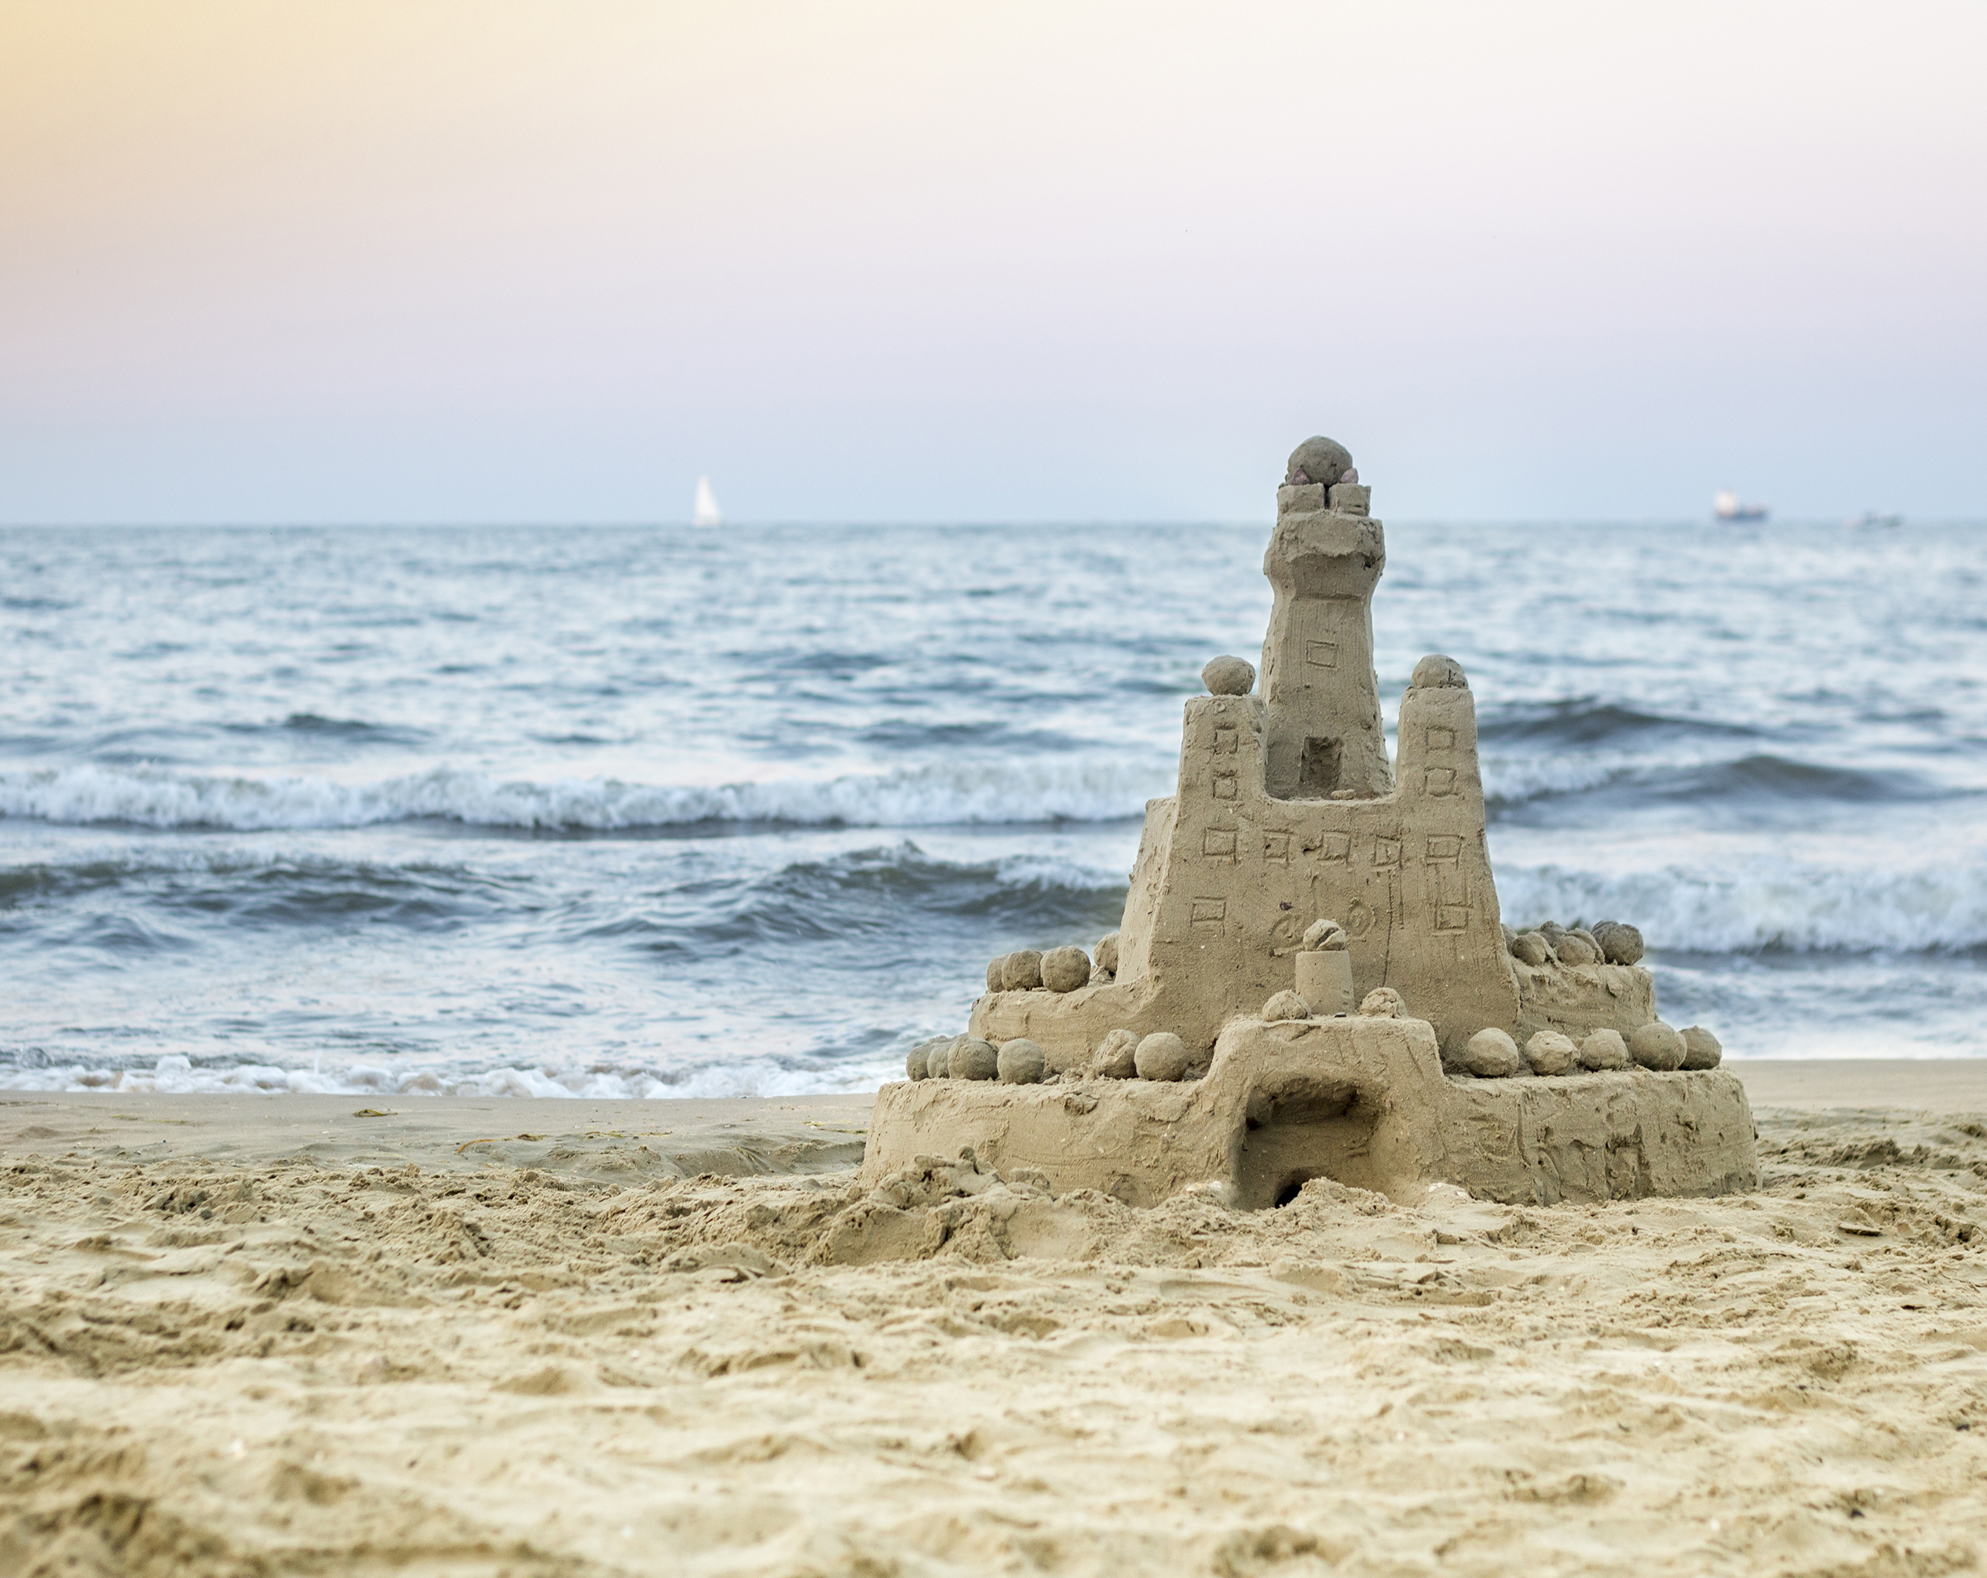
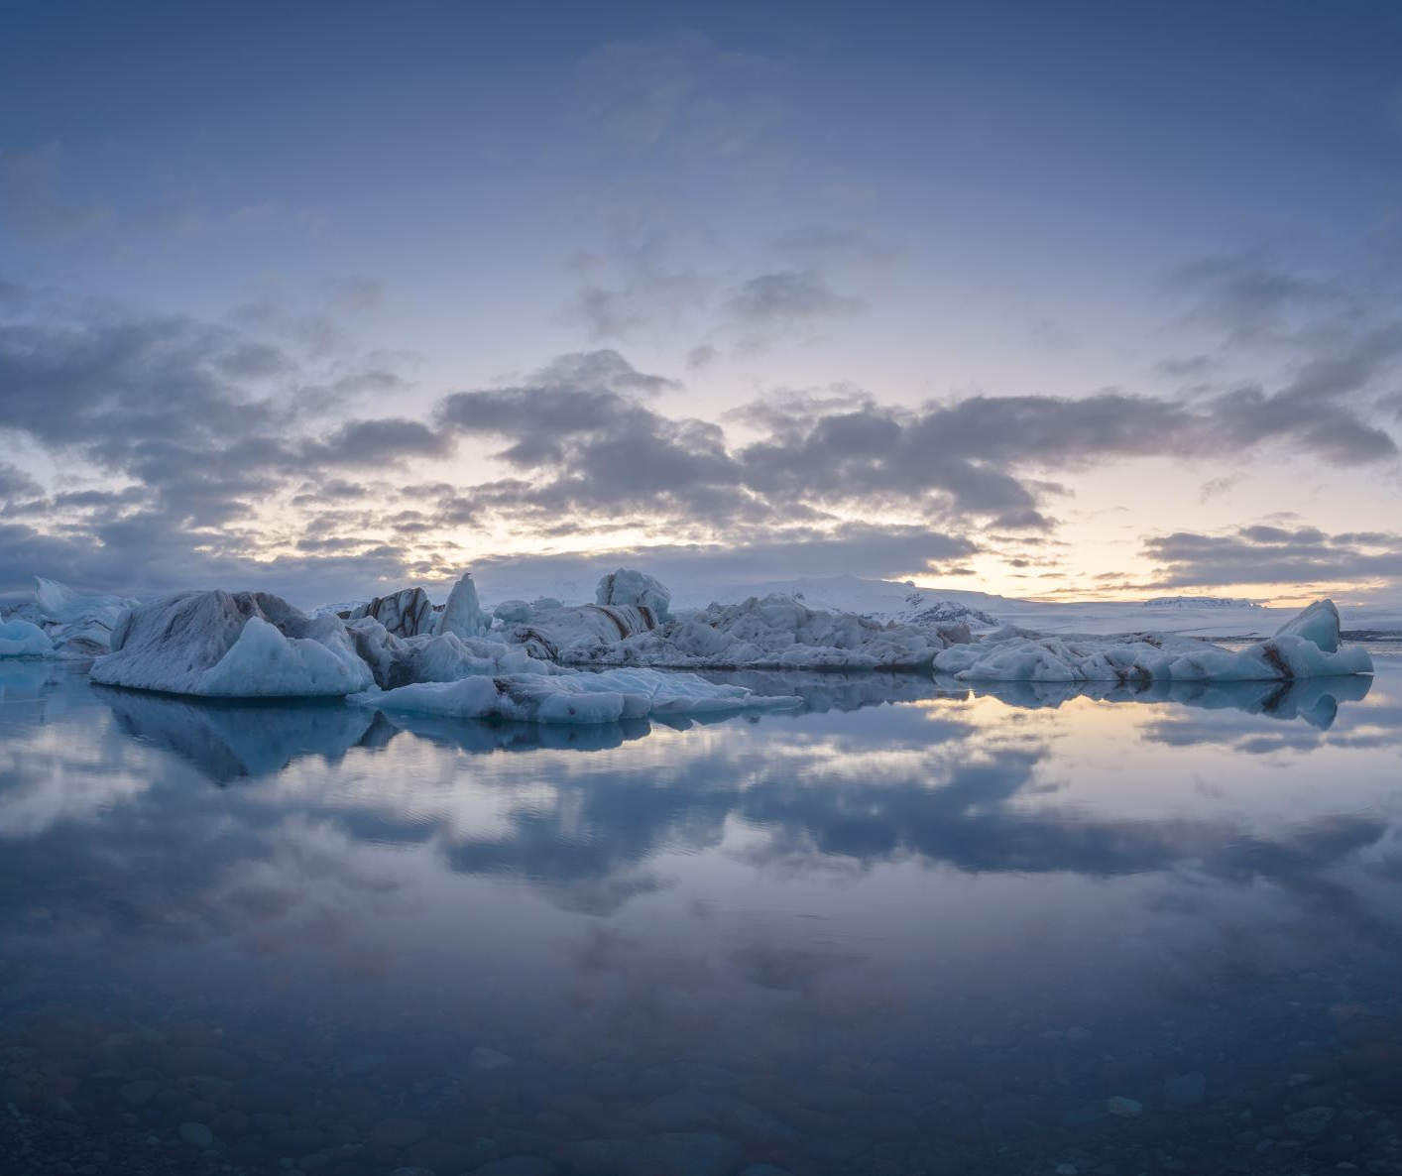
Project Summary
The project aims to mitigate risks associated with beachgoer safety by developing a forecasting system for inshore and offshore people density. The main objective is to develop a real-time beach security information system for beachgoers and improve safety at Kincardine’s Station Beach.
The current phase is to predict the people density visible in camera images. Implement a zoning system that categorizes beach areas (water, sand, etc.) for effective monitoring and communication. To develop a comprehensive system that segments beach zones and employs a model for identifying and counting individuals in specific areas.

Slide 6
Project Progress Update
Completed Work:
01/30/2024
Phase2 code replication – water segmentation model
Have worked on the prerequisite code and reflected the image labelling of water segmentation model.
Data pre-processing is completed and labelling of image data then training of image segmentation model is completed.
02/06/2024
Phase2 code replication successful – zone prediction model
Worked upon the Zone-prediction model set and the outcome images have been reviewed.
Worked on the Density map code using YOLOv4 set.
02/13/2024
Worked on the density map using Yolov5.
Generated csv file with the year 2022 image dataset and their corresponding people count on both water and sand for analysis purpose of data team.
02/22/2024
Improvised the density map using K-means Clustering and and implementing spatial density clusters in Yolov5.

Slide 7
Project Progress Update
02/27/2024
Worked on the improvement of the density map by creating different zones in both water and sand segments.
Each image was divided into 4 zones and separate density was detected.
03/06/2024
Worked on the improvement of the object class prediction in the density map with better accuracy.
03/13/2024
Worked on the density map using Faster R-CNN neural network model.
Analyzed both yolov5 and R-CNN density maps.
Results from using both the models in different zones and the density map accuracies were noted.
03/19/2024
Worked on the beach usage pixel percentage count with the Yolov5 and Faster R-CNN models integrated into the four zones of the images using the ensemble technique.
Results are compared to the separate model outputs of R-CNN and Yolov5.
03/26/2024
Worked on the Object detection of images using the YOLOv5 model and then classifying and counting the detected objects within four predefined zones in each image.
04/02/2024
Worked on the image classification technique using ensemble of yolov5 and Faster R-CNN detections.
04/11/2024
Completed the Evaluation metrics update of precision, recall and accuracy for the Yolov5 and Faster R-CNN model detections.

Slide 8
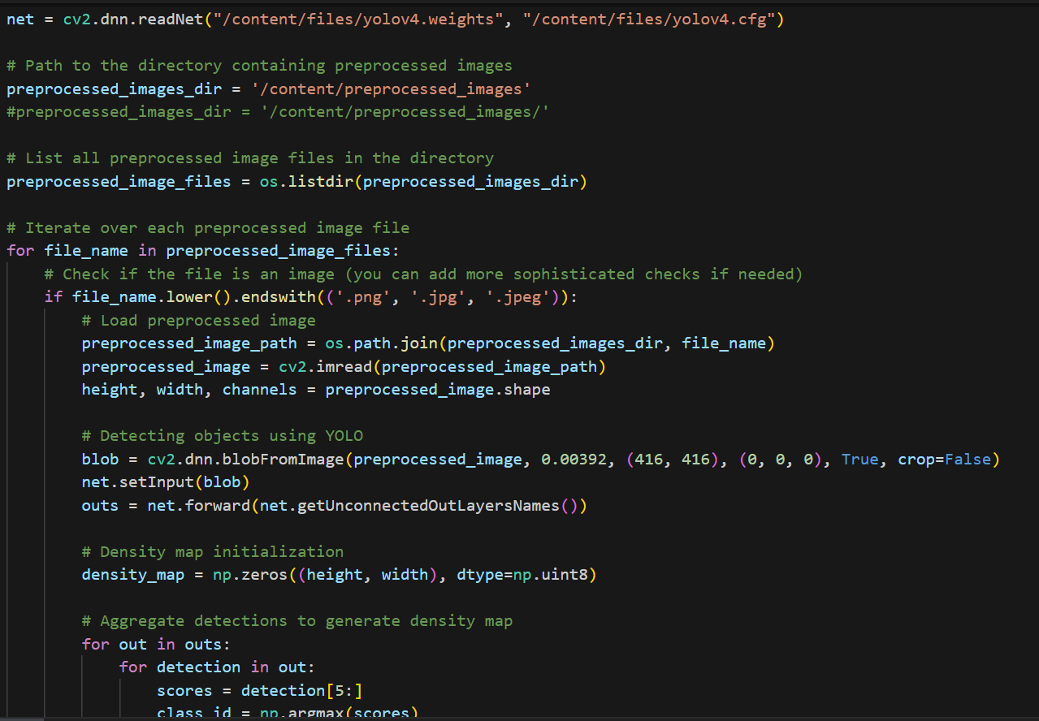
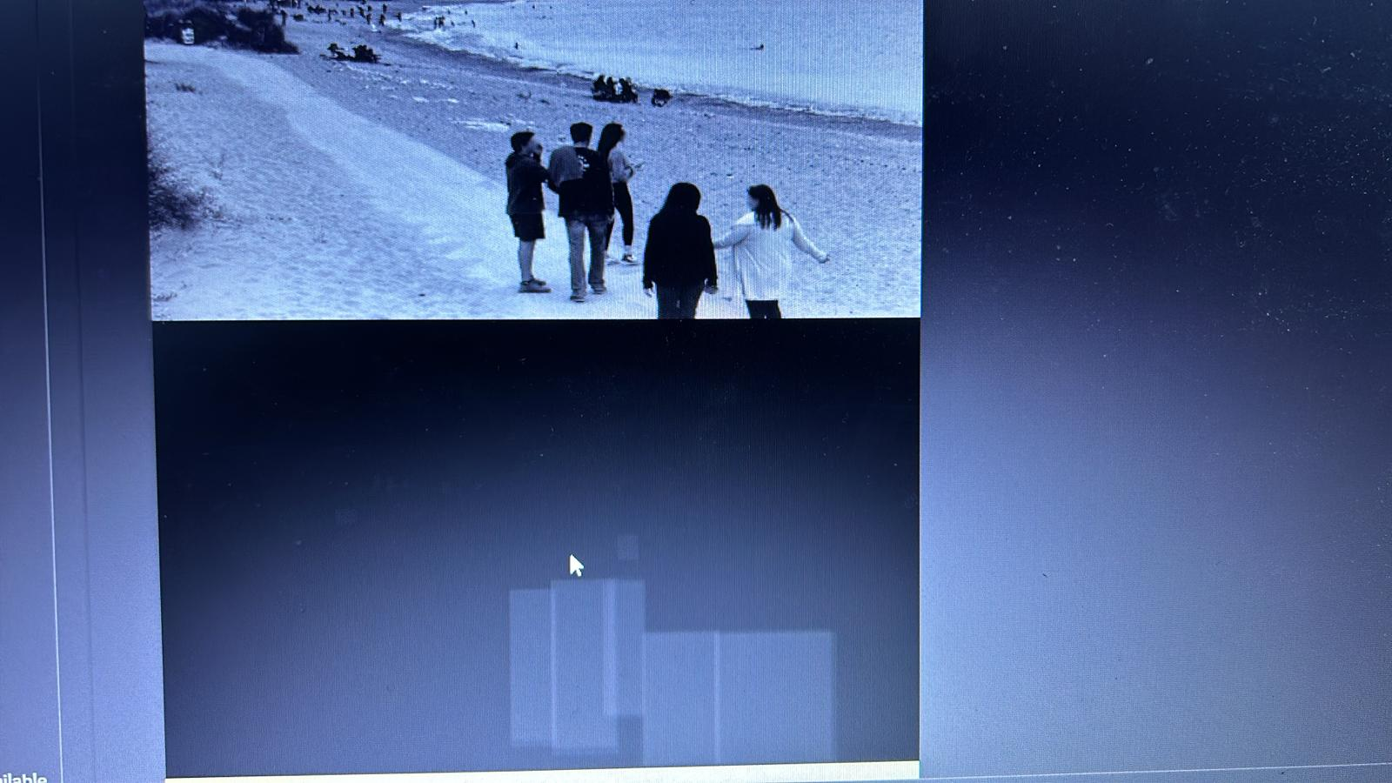
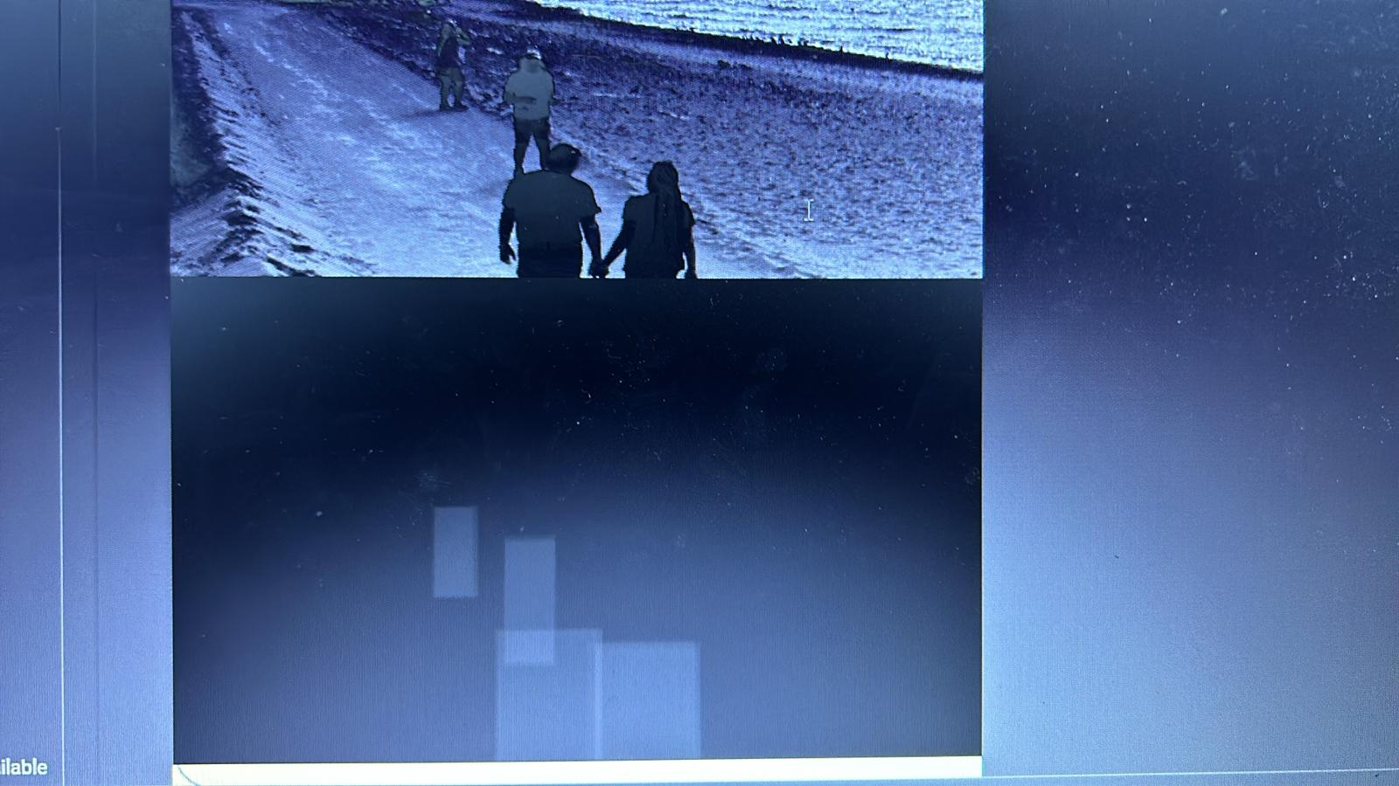
Code and Output Snippets
Density map with Yolov4 – 02/06/2024

Slide 9
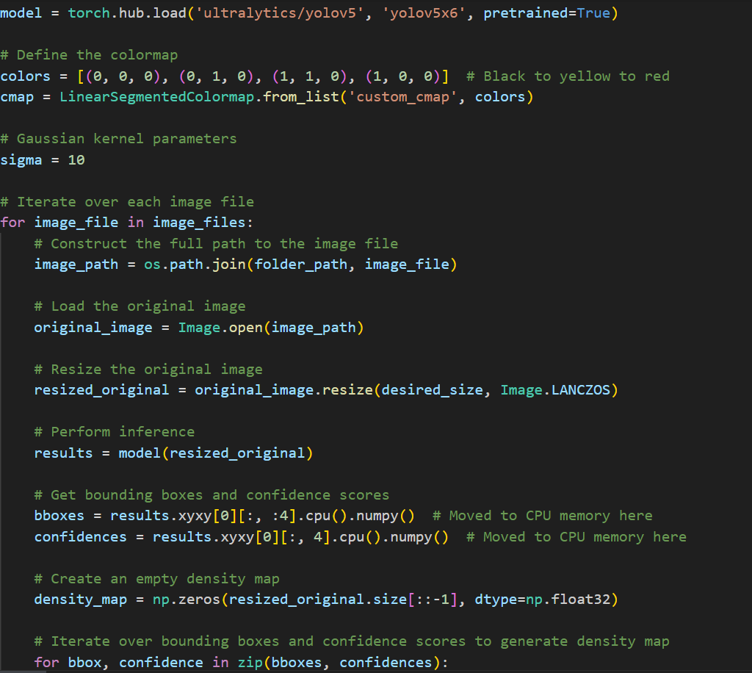
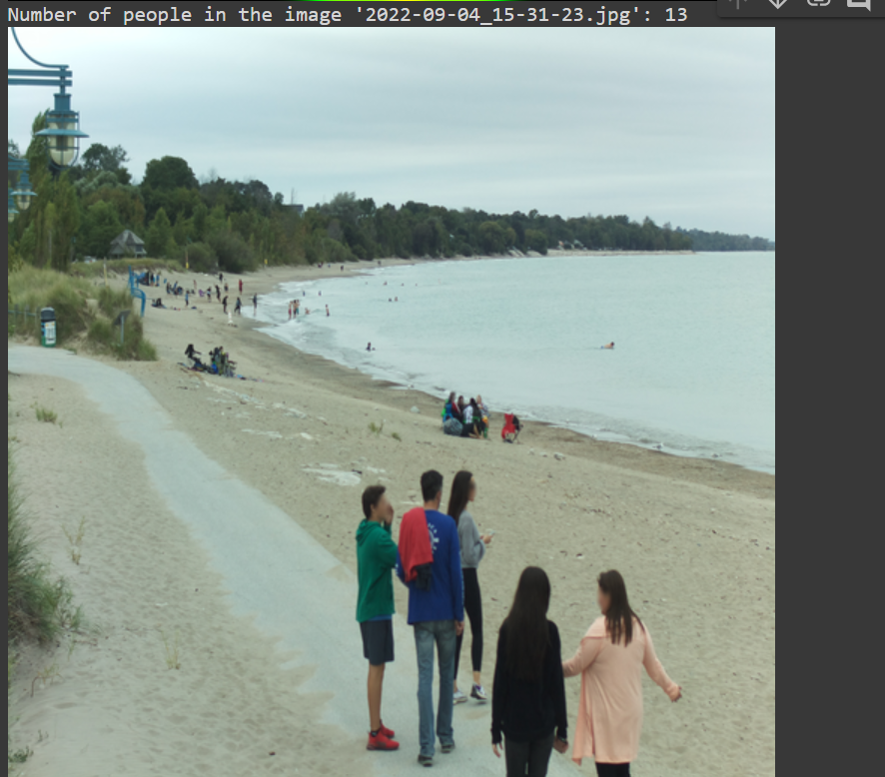
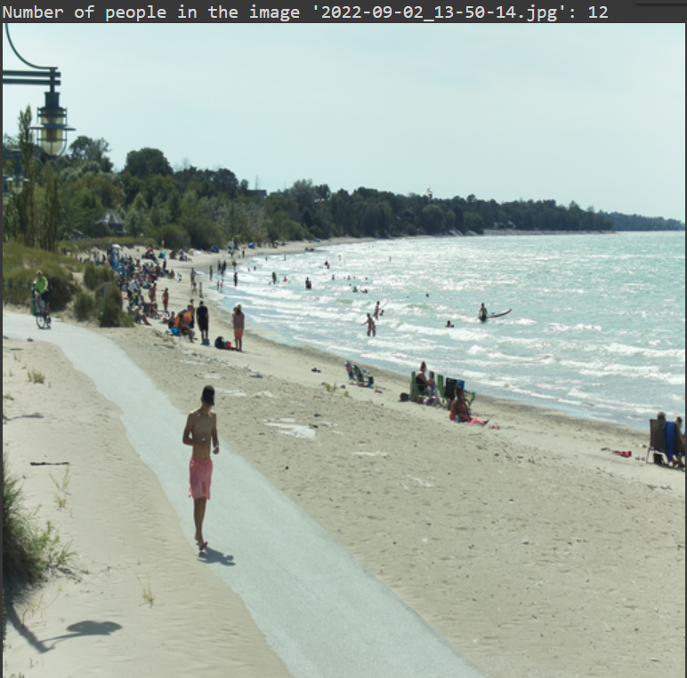
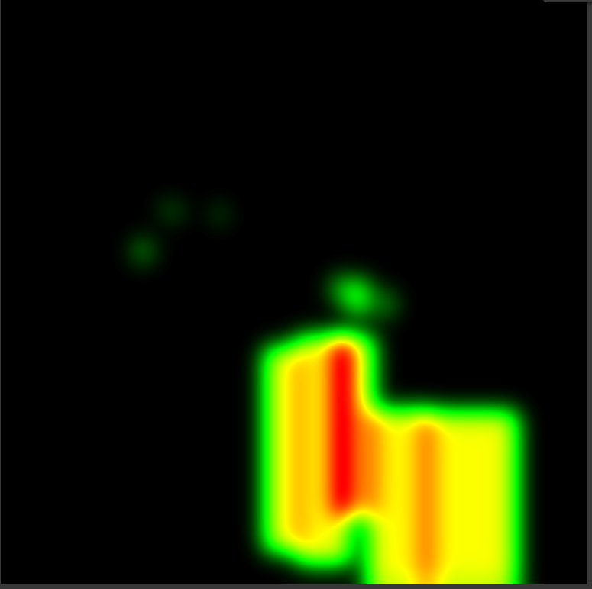
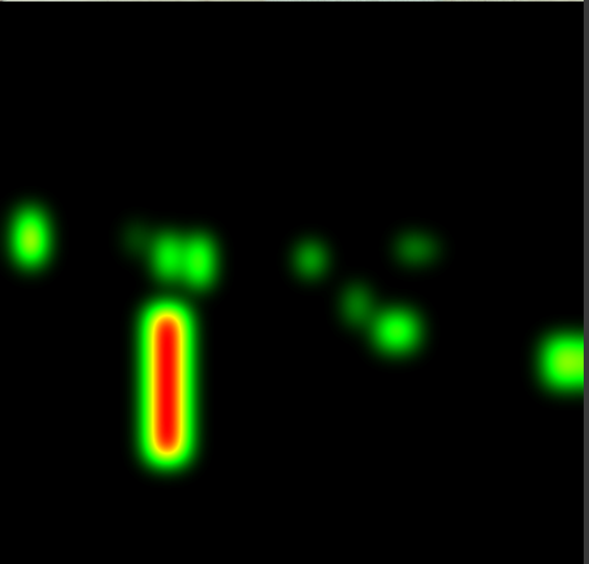
Code and Output Snippets
Density map with Yolov5 – 02/13/2024

Slide 10
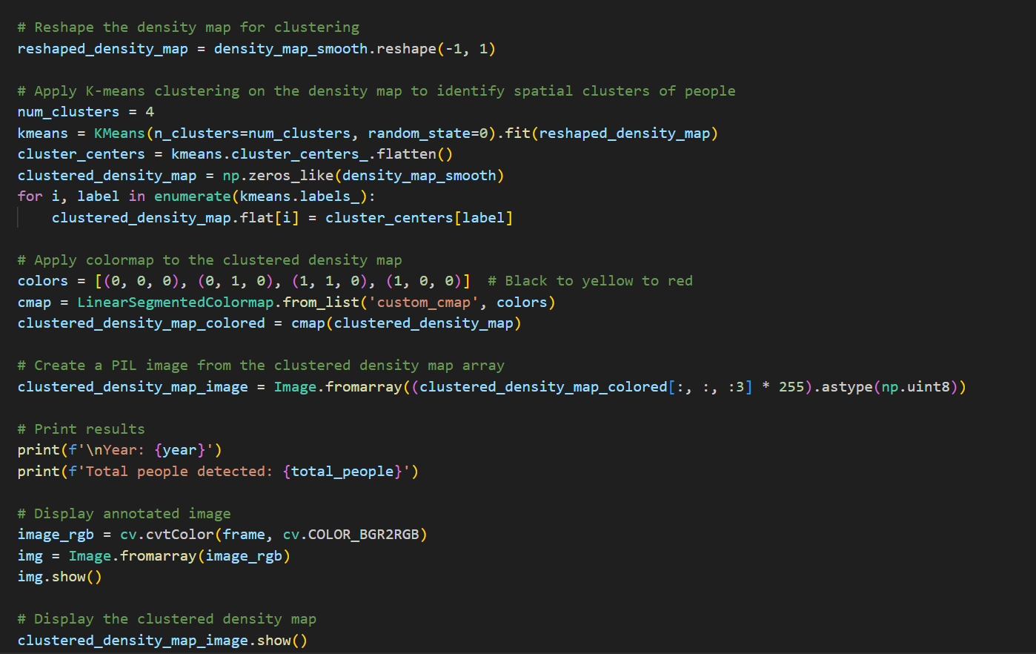
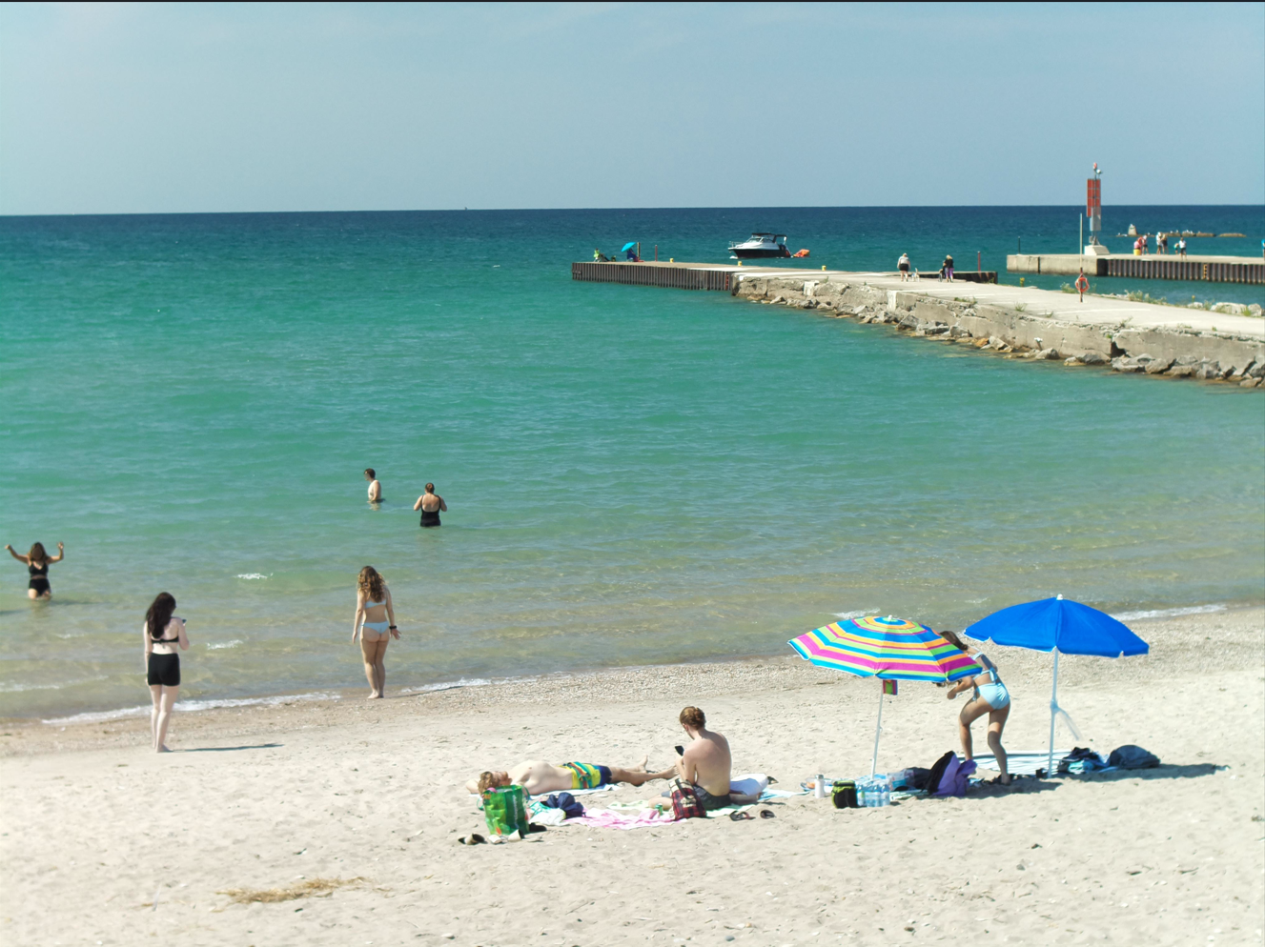
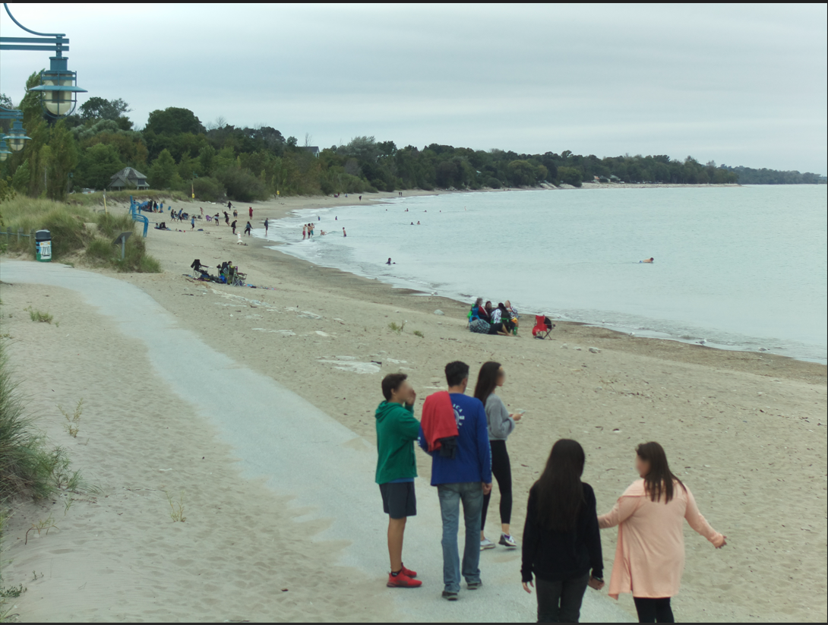
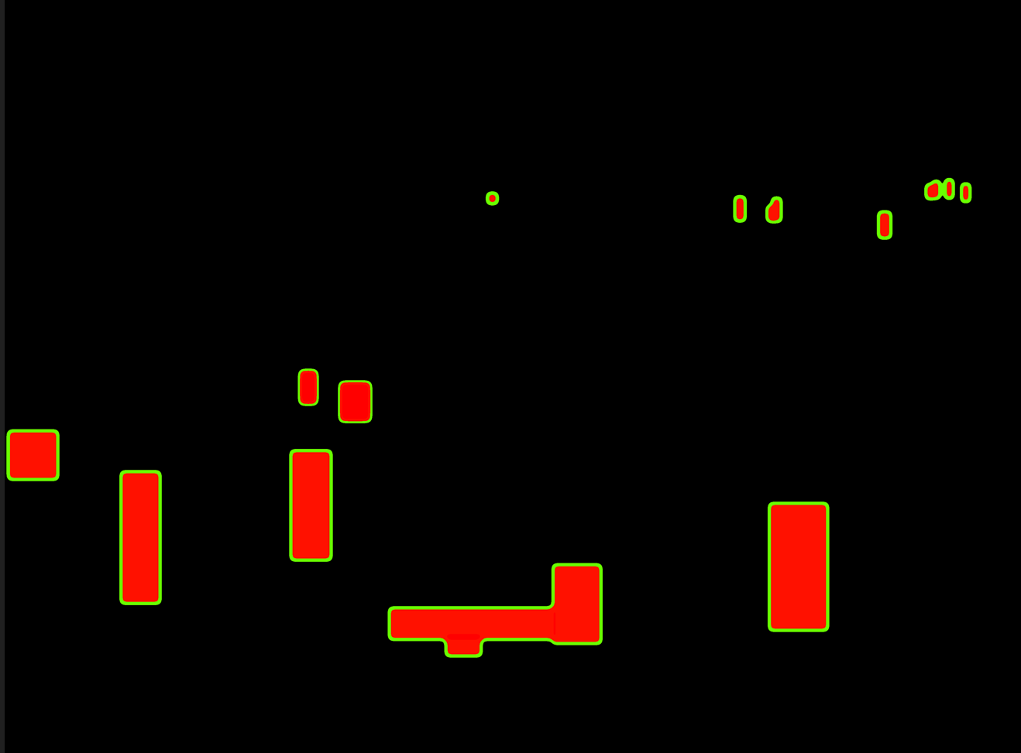
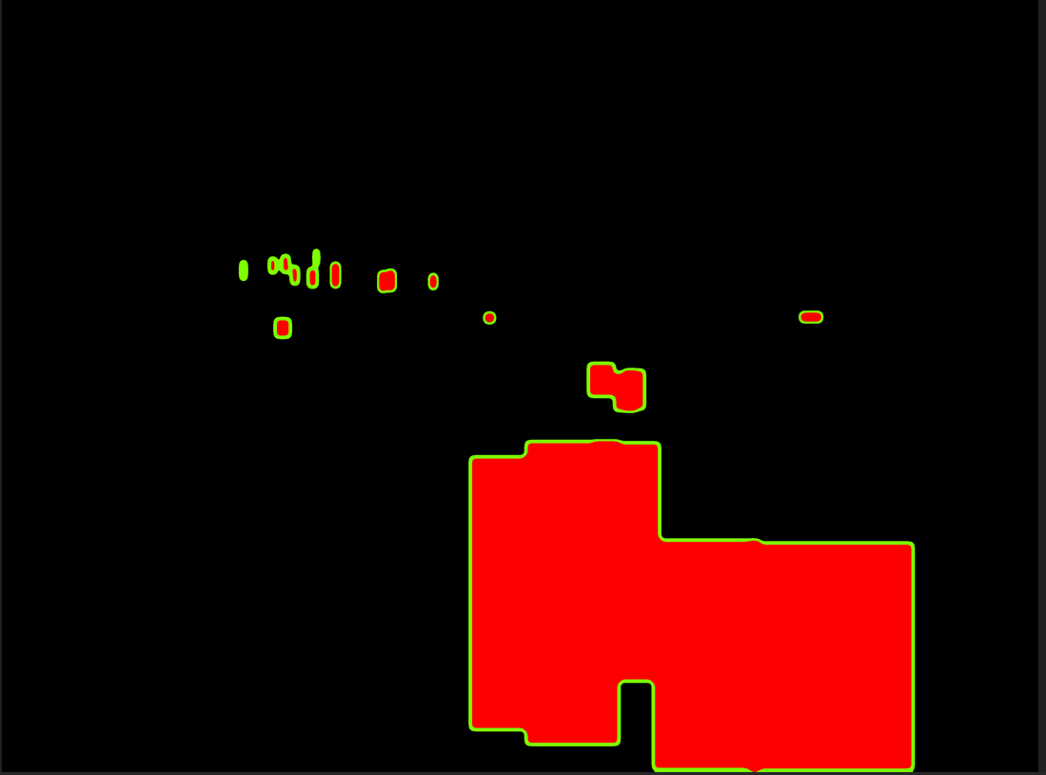
Code and Output Snippets
Zone-wise with density map clustering for beach image analysis using Yolov5 – 02/20/2024

Slide 11
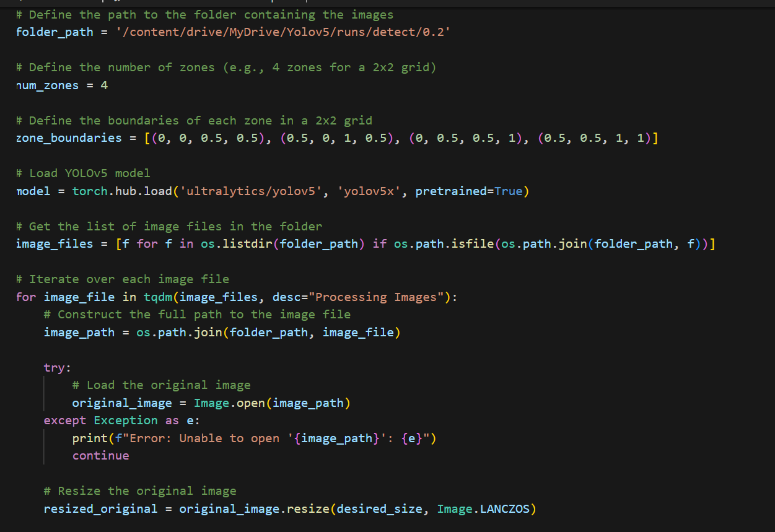
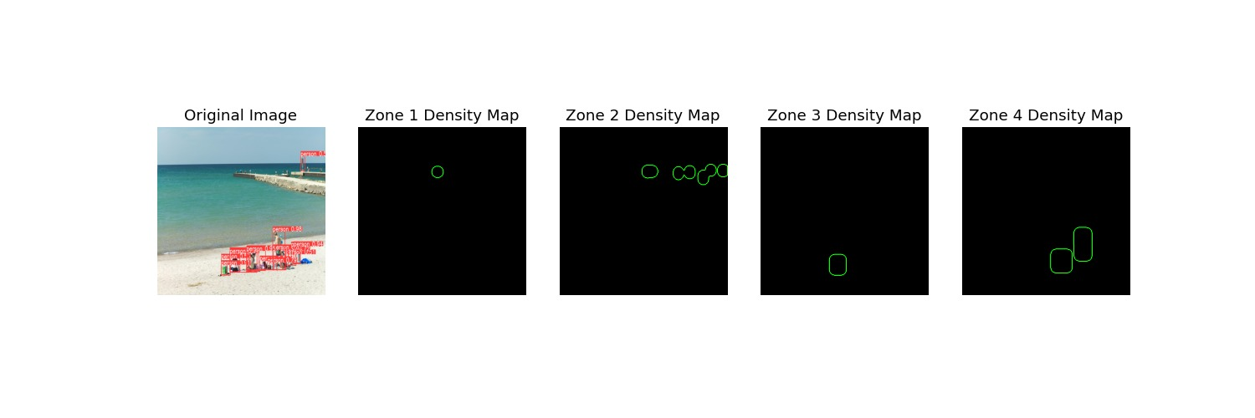
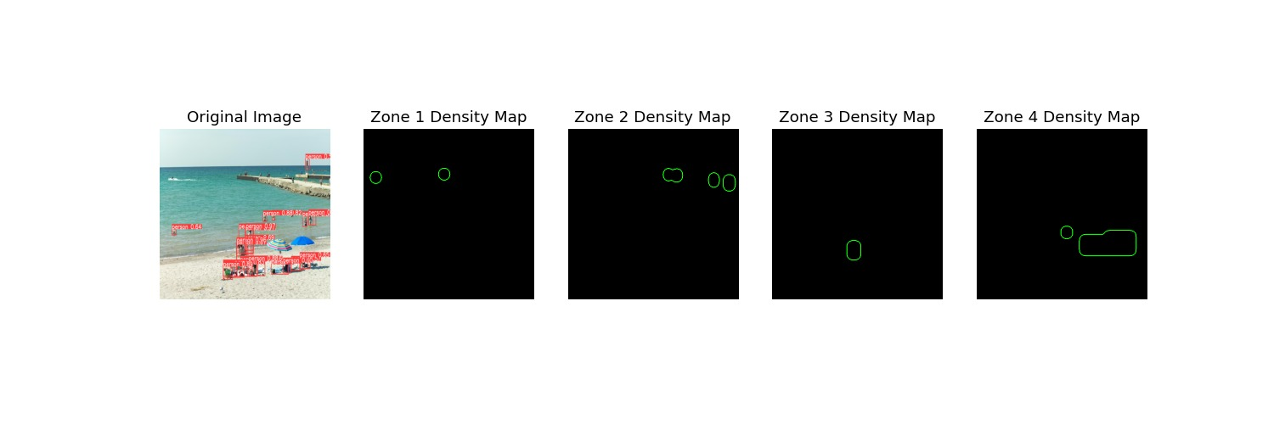
Code and Output Snippets
4 zones plotted and density map analyzed – 02/27/2024

Slide 12
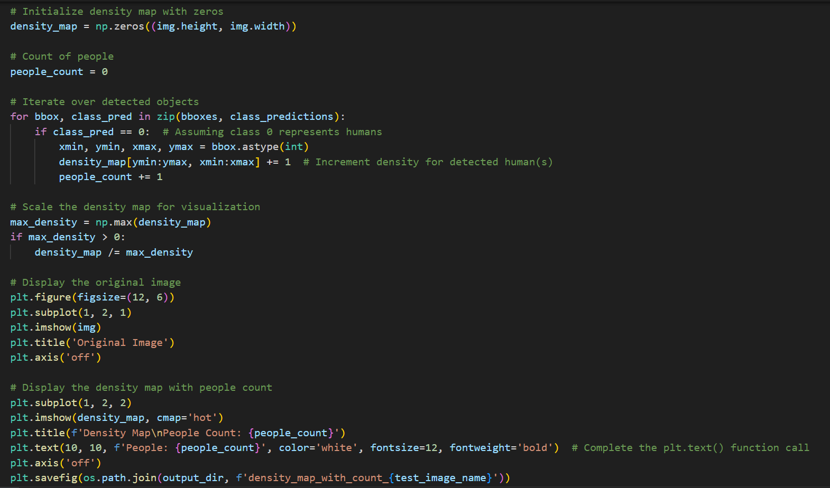
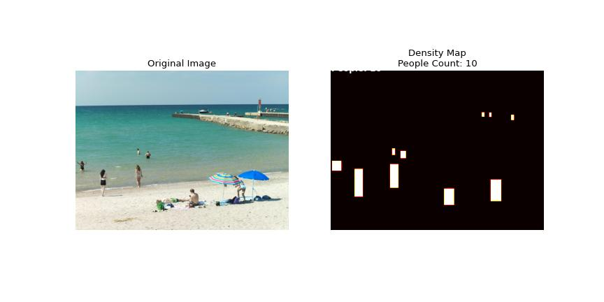
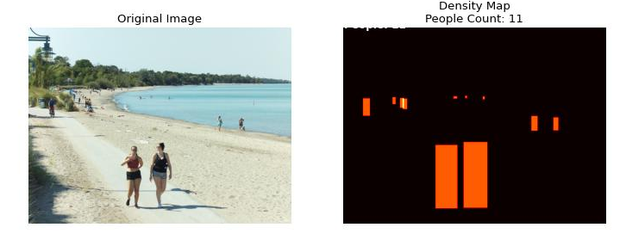
Code and Output Snippets
Zone-wise Density Map using yolov5– 03/06/2024

Slide 13
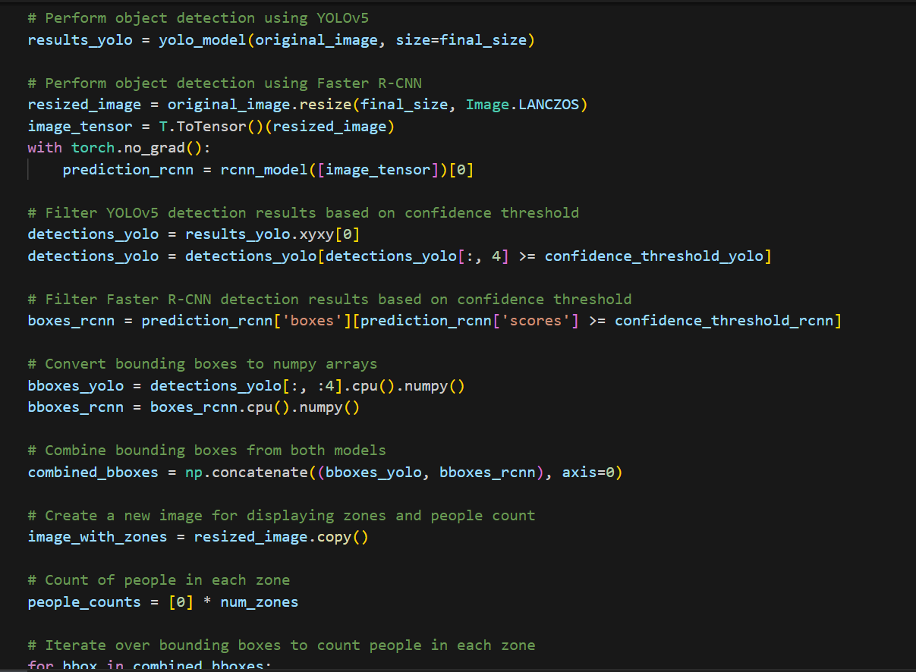
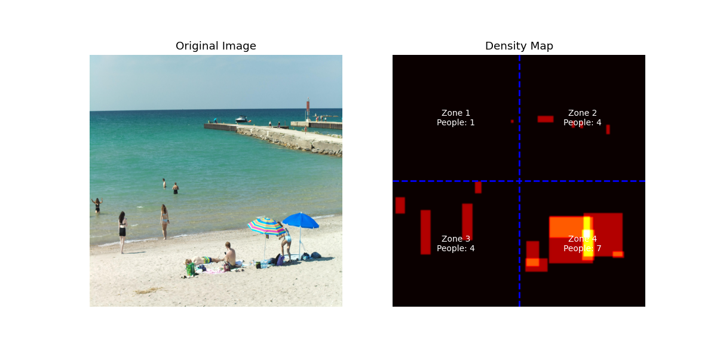
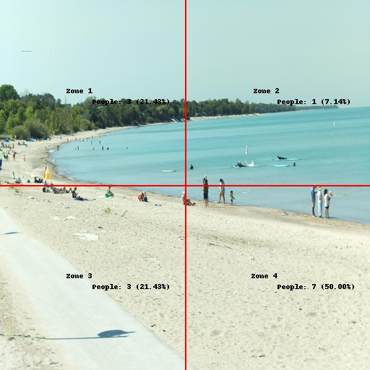

Code and Output Snippets
Zone-wise Density Map using faster r-cnn – 03/13/2024
Comparison of people count in both Yolov5 and R-CNN

Slide 14
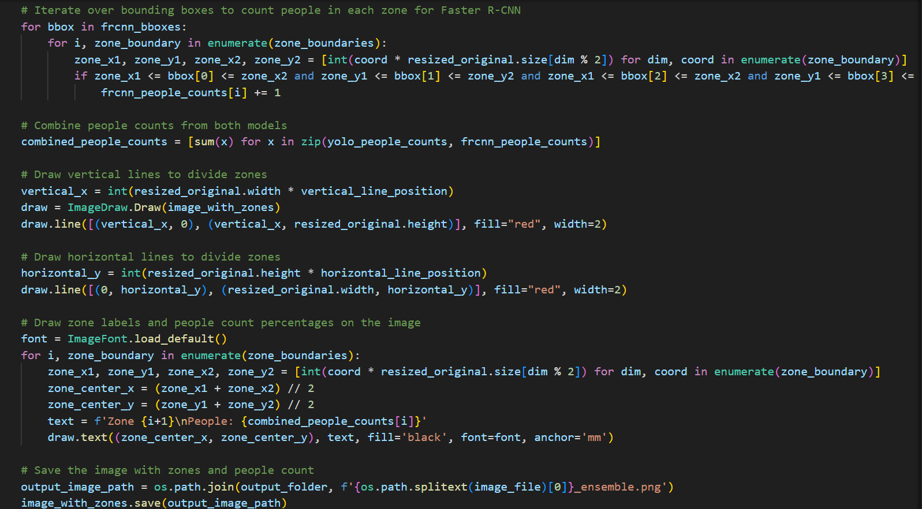
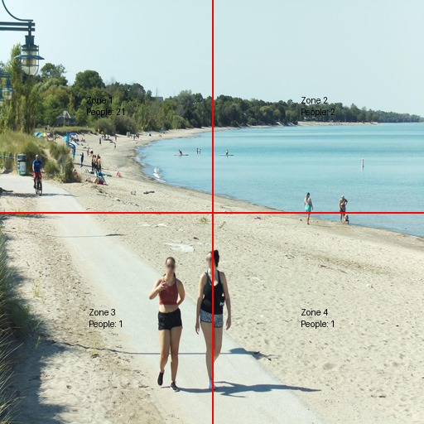
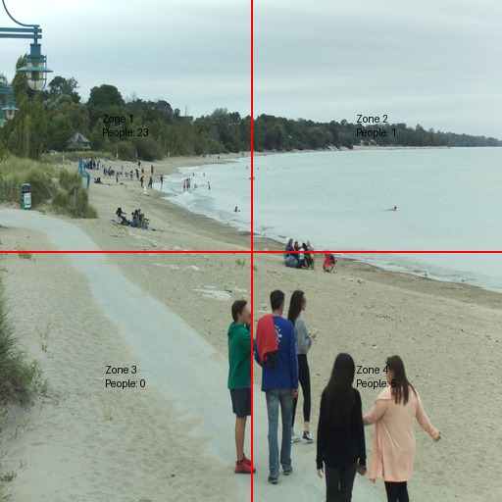
Code and Output Snippets
Beach usage rates with both r-cnn and yolov5 – ensemble technique – 03/19/2024
Zone 1: 21
Zone 2: 2
Zone 3: 1
Zone 4: 1
Zone 1: 23
Zone 2: 1
Zone 3: 0
Zone 4: 6

Slide 15
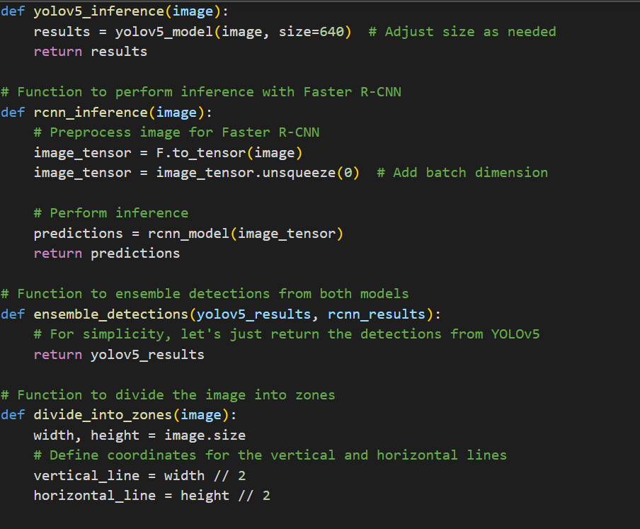
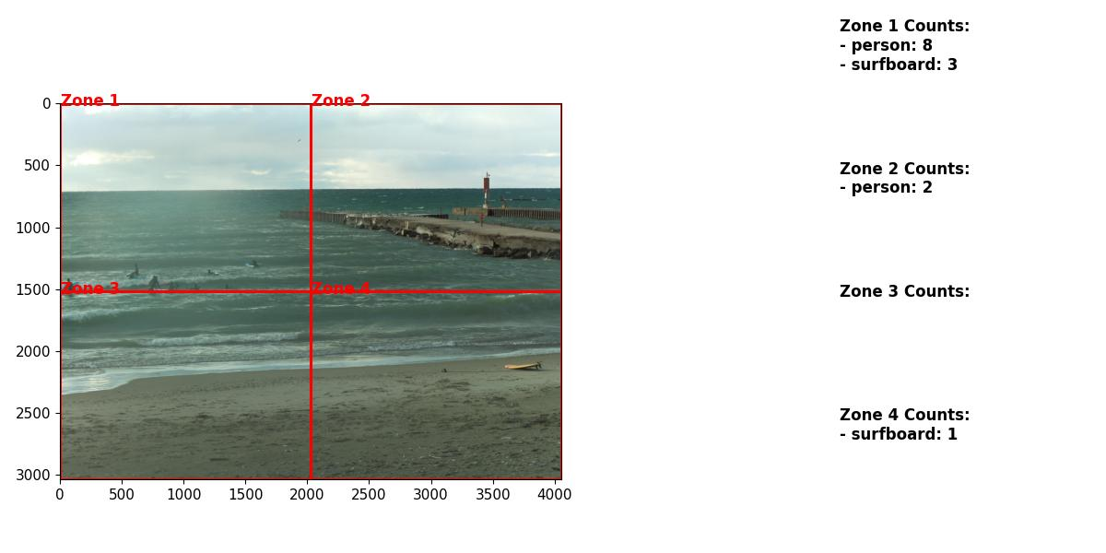
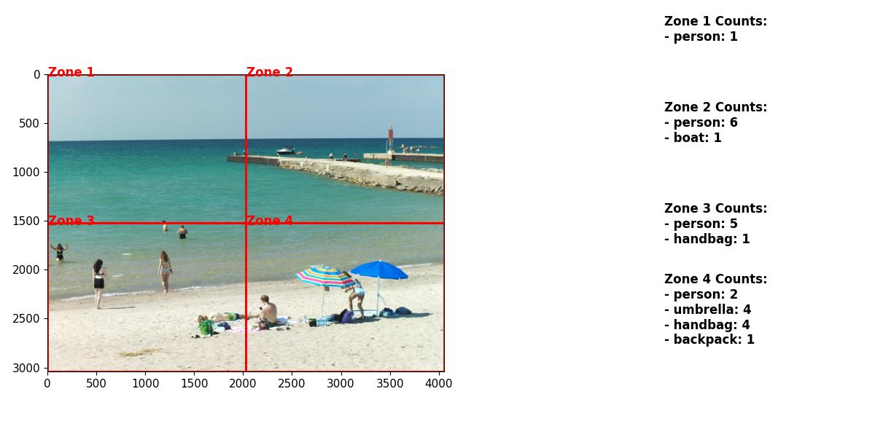
Code and Output Snippets
Object Detected Counts using Yolov5 - 03/26/2024

Slide 16
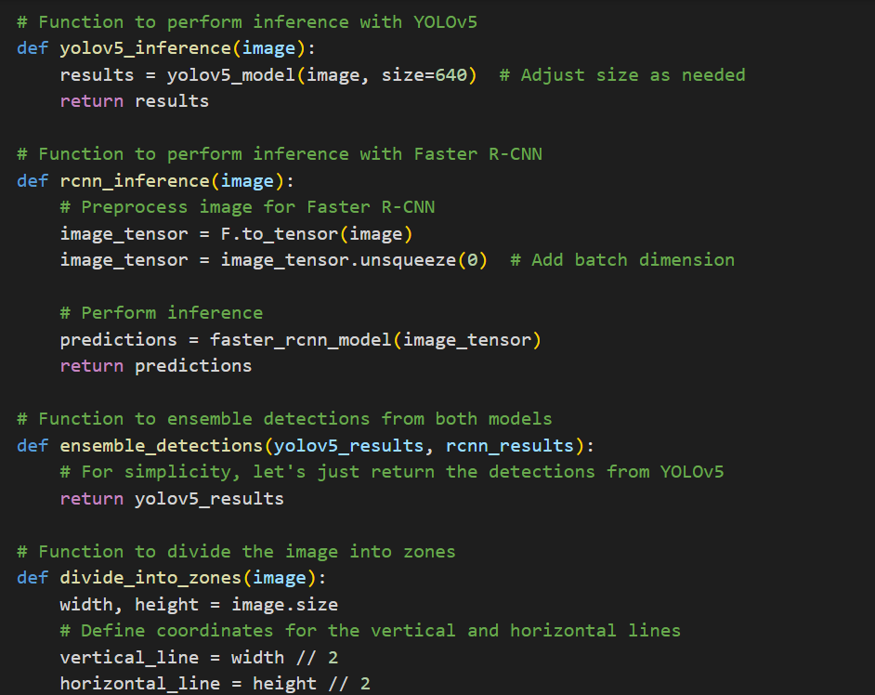
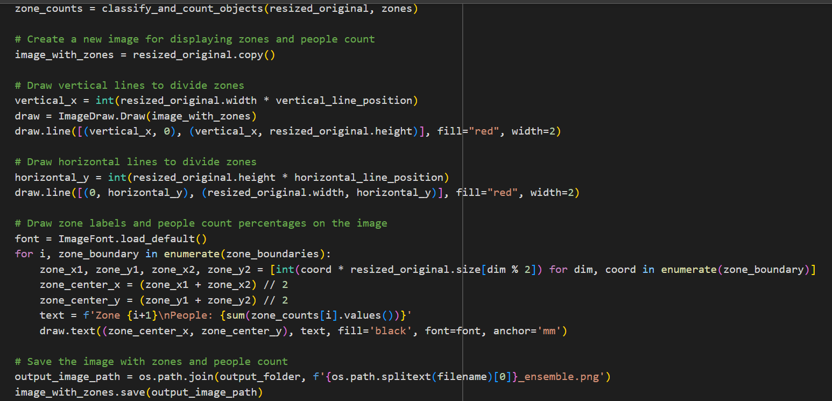
Code and Output Snippets
Image Classification with Ensembling Yolov5 and Faster R-CNN detections– 04/04/2024

Slide 17
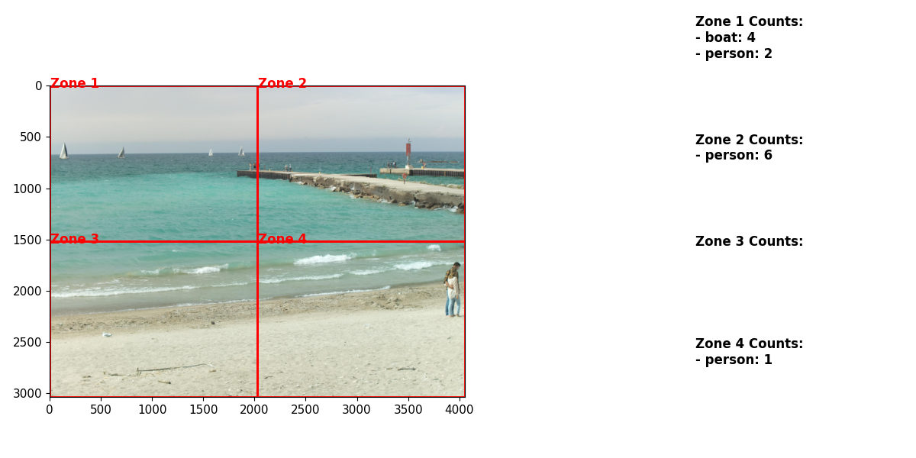
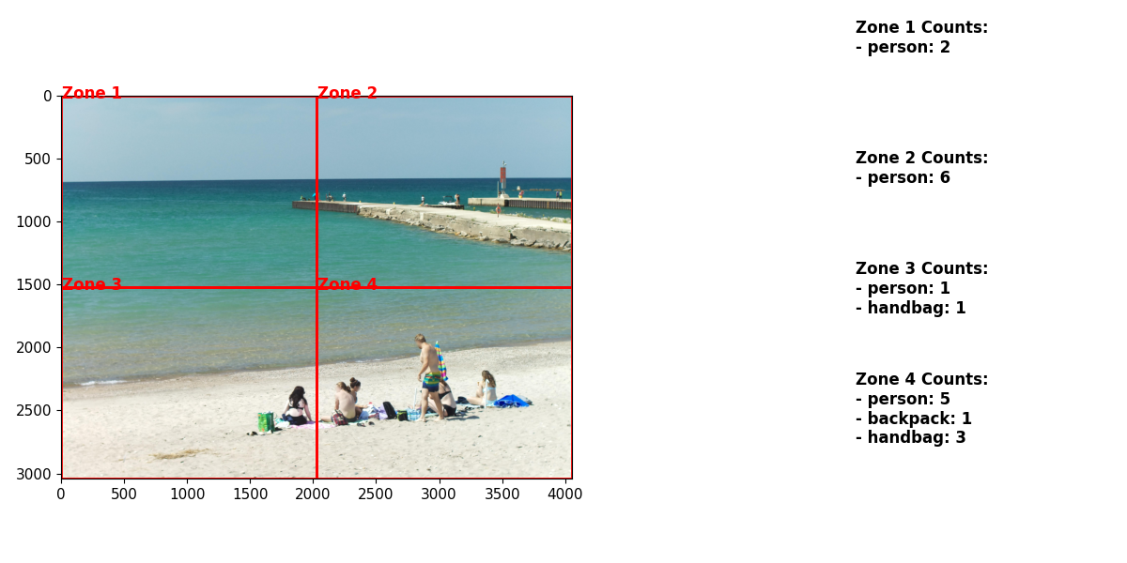
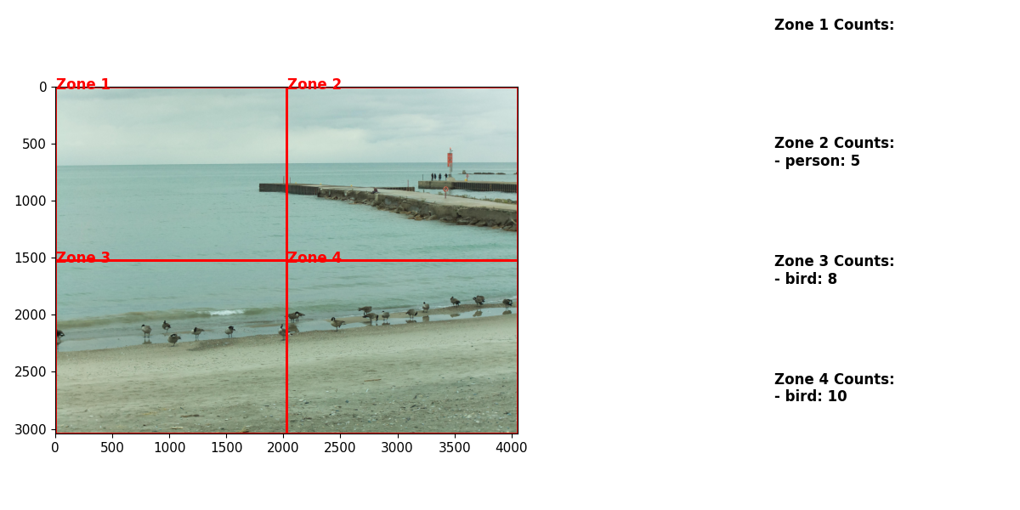
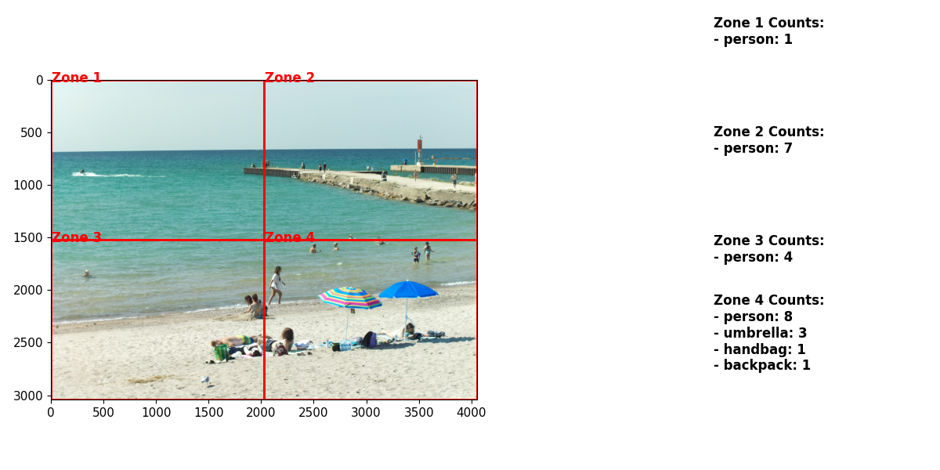
Code and Output Snippets
Image Classification with Ensembling Yolov5 and Faster R-CNN detections– 04/04/2024

Slide 18
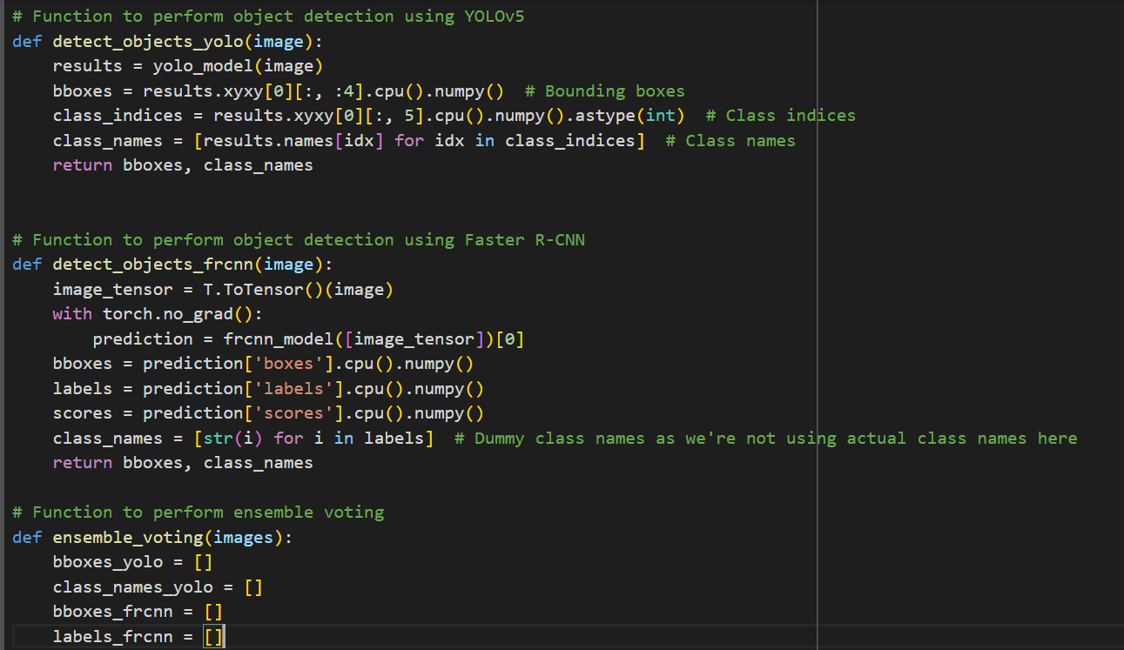
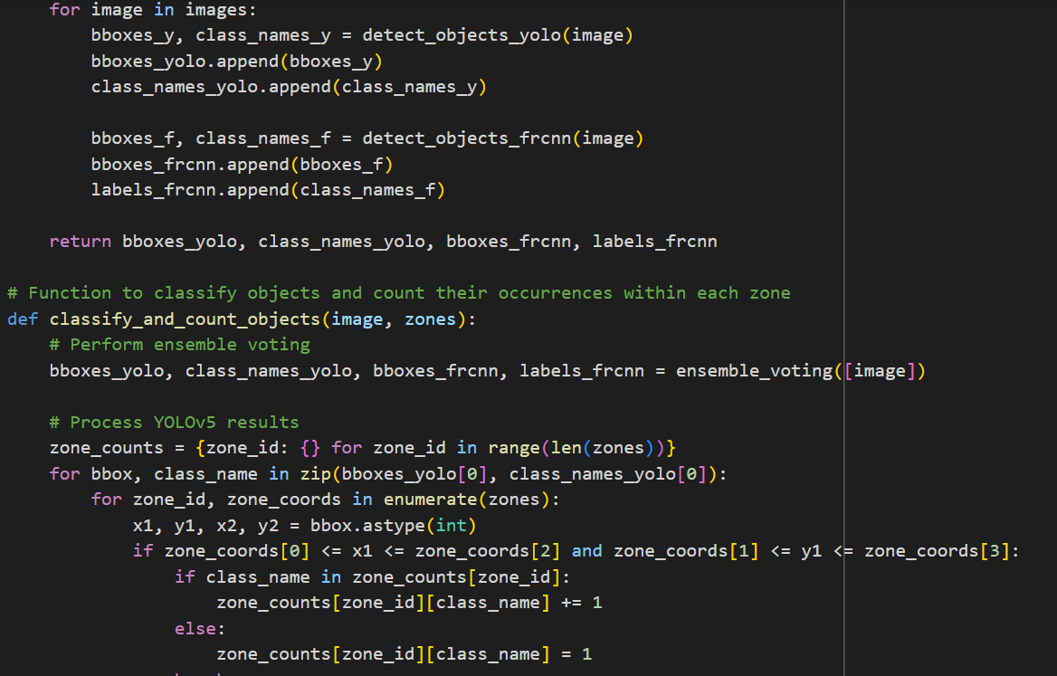
Code and Output Snippets
Image Classification with Ensembling Yolov5 and Faster R-CNN detections with Accuracy, Precision and Recall Values– 04/10/2024

Slide 19
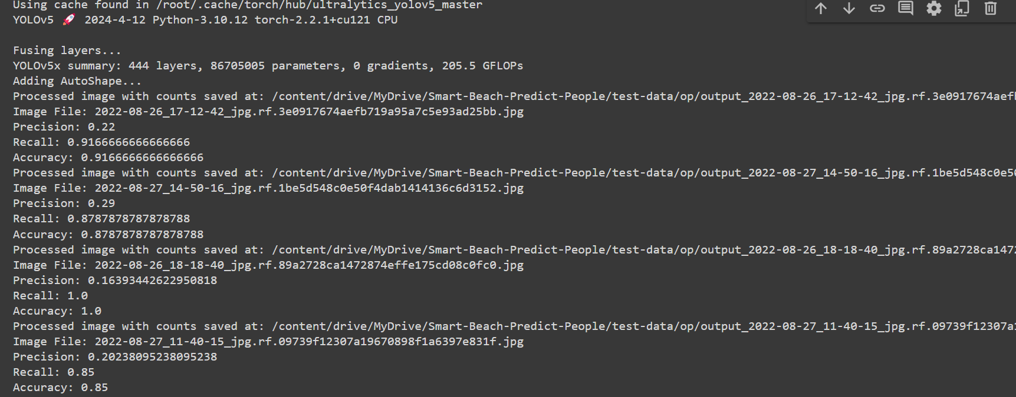
Code and Output Snippets
Image Classification with Ensembling Yolov5 and Faster R-CNN detections with Accuracy, Precision and Recall Values– 04/10/2024

Slide 20
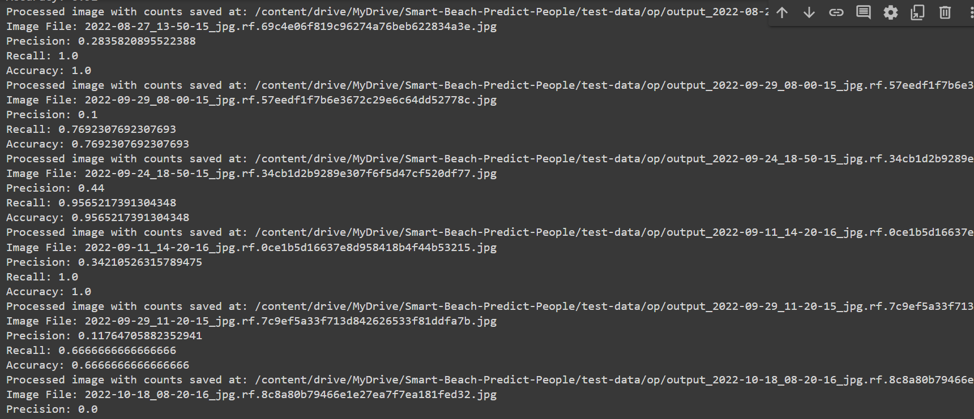
Code and Output Snippets
Image Classification with Ensembling Yolov5 and Faster R-CNN detections with Accuracy, Precision and Recall Values– 04/10/2024

Slide 21
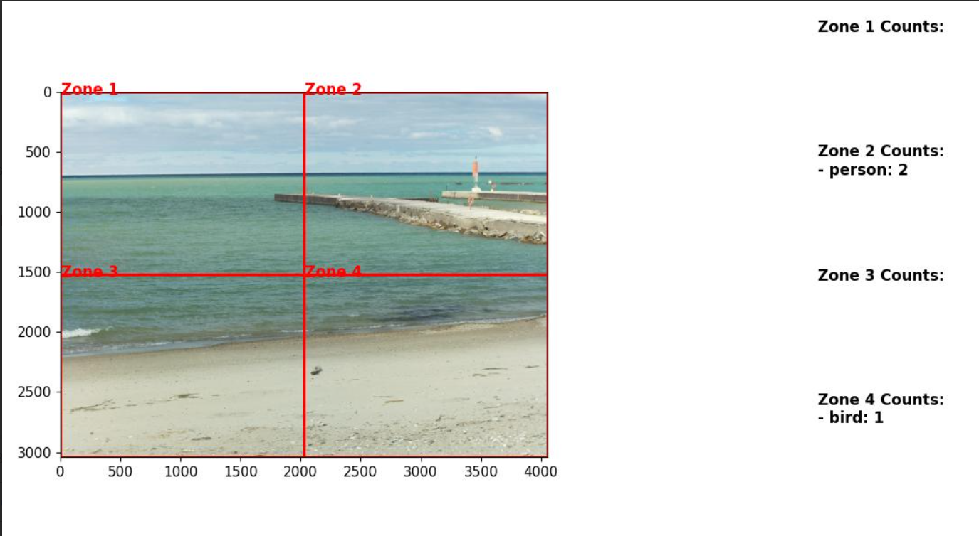
Code and Output Snippets
Image Classification with Ensembling Yolov5 and Faster R-CNN detections with Accuracy, Precision and Recall Values– 04/10/2024
Precision: 0.11764705882352941 Recall: 0.6666666666666666 Accuracy: 0.6666666666666666

Slide 22

Code and Output Snippets
Image Classification with Ensembling Yolov5 and Faster R-CNN detections with Accuracy, Precision and Recall Values– 04/10/2024
Precision: 0.44
Recall: 0.9565217391304348 Accuracy: 0.9565217391304348

Slide 23

Code and Output Snippets
Image Classification with Ensembling Yolov5 and Faster R-CNN detections with Accuracy, Precision and Recall Values– 04/10/2024
Precision: 0.27058823529411763 Recall: 0.92
Accuracy: 0.92

Slide 24

Code and Output Snippets
Image Classification with Ensembling Yolov5 and Faster R-CNN detections with Accuracy, Precision and Recall Values– 04/10/2024
Precision: 0.44
Recall: 0.9565217391304348 Accuracy: 0.9565217391304348

Slide 25
Communication plan
Name ​​ | Role​​ | Send/Receive​​ Email​​ | Weekly Meetings​​ Thursday – 10.00 am | Decisions​​ | Documentation​​
Dr. Alex & Rich Freeman | Client​​ | Yes​​ | Attendee | Project Scope​​ and ​​Project plan | Project documentation​​ ​​
Sanjeev Kumar​​ | Instructor​​ | Yes​​ ​​ | Optional Attendee​​ ​​ | Progression of Project​​ ​​ | Grading​​ ​​
Brunilda Xhaferllari​​ ​​ | Project Manager​​ | Yes​​ ​​ | Suggested Attendee​​ ​​ | Project and Task Management related items​​ ​​ | Project Management Presentation components​​ ​​
Ruwindhu Hettige | Project co-ordinator | Yes | ​​Attendee | Progression of Project​​ | ​​ Project co-ordinator​​
Mahima Srinivasan | ML Engineer​​ | Yes​​ ​​ | Attend​​ee ​​ | Team, Project and Own Tasks​​ ​​ | Communication/Presentation​​ ​​
Nishanth Sai Chirumamilla | ML Engineer​​ | Yes​​ ​​ | Attend​ee​ ​​ | Team, Project and Own Tasks​​ ​​ | Communication/Presentation​​ ​​
Vinay Kumar Dontarmina | ML Engineer​​ | Yes​​ ​​ | Attendee | Team, Project and Own Tasks​​ ​​ | Communication/Presentation​​ ​​

Slide 26
Gantt Chart
 | Month 1 |  |  |  | Month 2 |  |  |  | Month 3
Project Progress | Week 1 | Week 2 | Week 3 | Week 4 | Week 5 | Week 6 | Week 7 | Week 8 | Week 9 | Week 10 | Week 11 | Week 12
Project planning
Data collection
Data preprocessing
Model labelling and training
Testing image data in water segmentation and zone-based prediction model
Algorithm for density map based on YOLO functionality
Improving model accuracy based on the prediction data
Testing & Evaluation
Deployment & Documentation

Slide 27




Summary
Providing beachgoers with up-to-date information so they can stay safe on the beach and segmenting the zones, building a model to identify people on the beach water and sand, further counting the people in these zones.

Slide 28

Thank You

